Slide 1
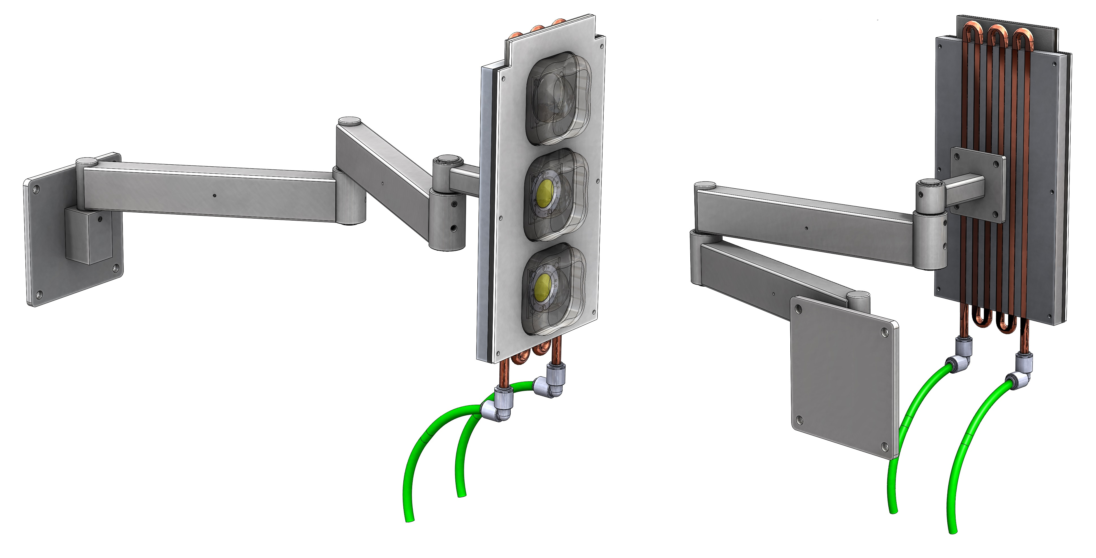
LHC Arm research
Options for Off-the-Shelf design components

Slide 2
Limited Off-the-Shelf Adjustability

Slide 3
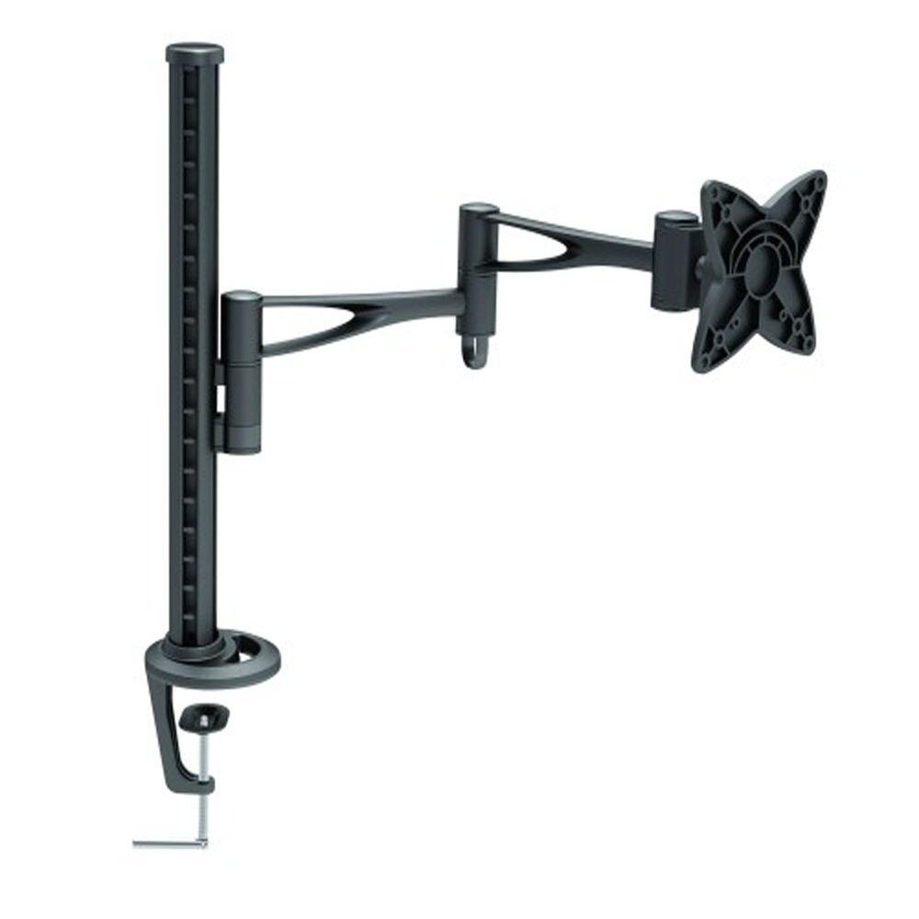
Notable Features
Max extension: 18 inches
Vertical range: 0 inches
Max weight: 33lbs
Cost: $95
https://www.homedepot.com/p/TygerClaw-Single-Arm-Desk-Mount-for-10-in-24-in-Monitor-LCD6406BLK/206443958

Slide 4
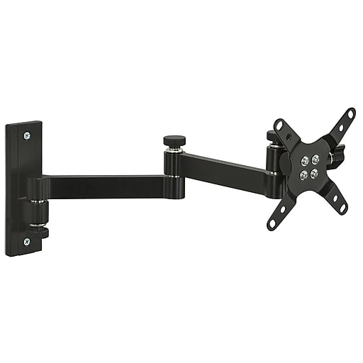
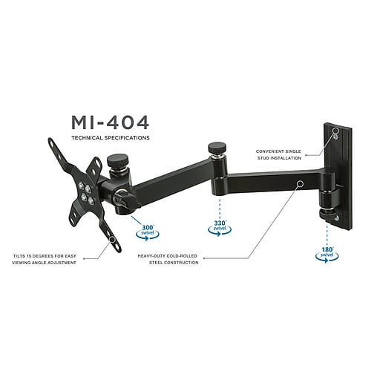
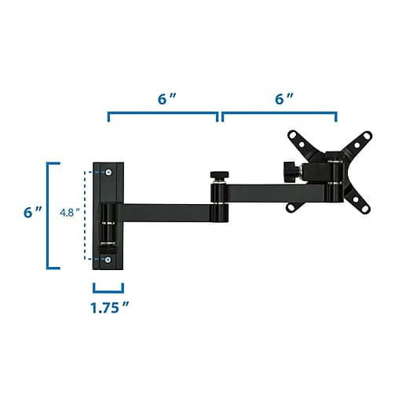
Notable Features
Max extension: 14 inches
Vertical range: 0 inches
Max weight: 33lbs
Cost: $26
https://www.staples.com/Mount-It-MI-404-Single-Monitor-Wall-Mount/product_2093816?cid=PS:GooglePLAs:2093816&ci_src=17588969&ci_sku=2093816&KPID=2093816&gclid=CjwKCAiAkrTjBRAoEiwAXpf9CemhWkvrqQpRPm2UHaQCJP1pc_sjX7CAlpmUvVnRXctuO1UpkFHbPhoCG64QAvD_BwE#

Slide 5
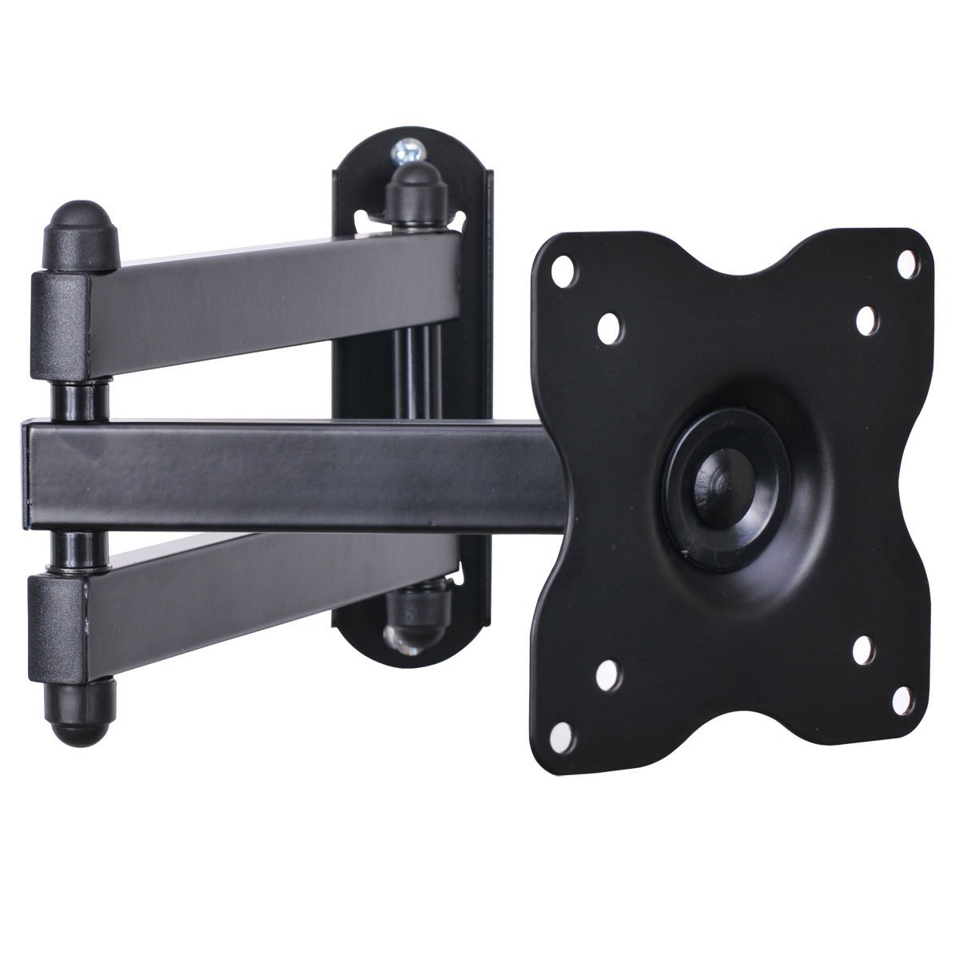
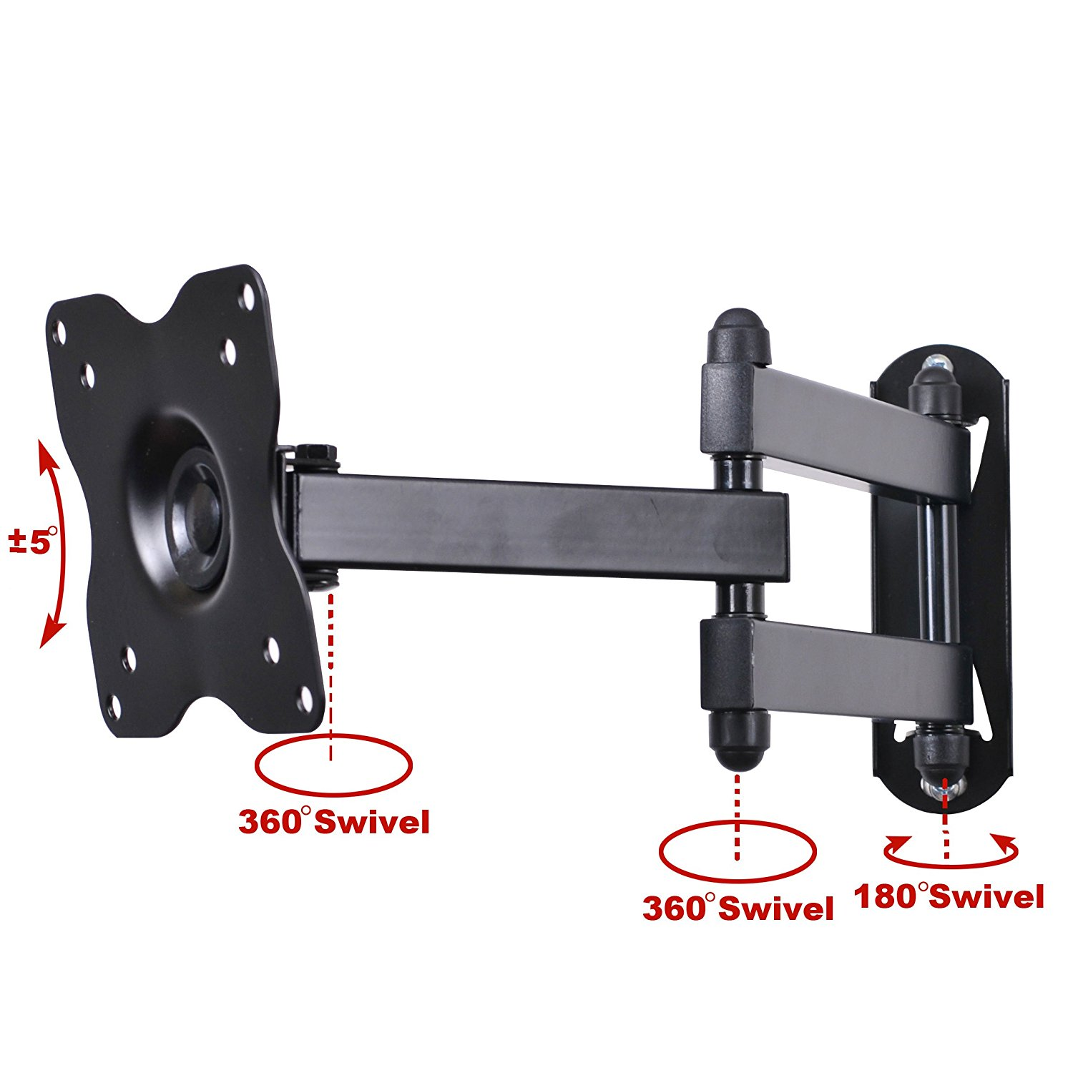
Notable Features
Max extension: 15 inches
Vertical range: 0 inches
Max weight: 44lbs
Cost: $14
https://www.amazon.com/VideoSecu-Monitor-Extension-Articulating-100x100/dp/B003O1UYHG

Slide 6
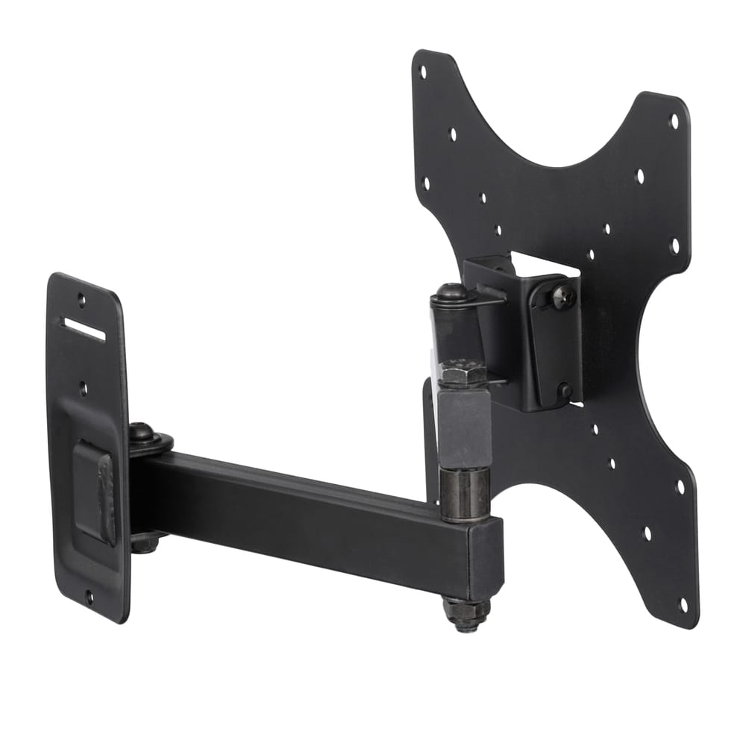
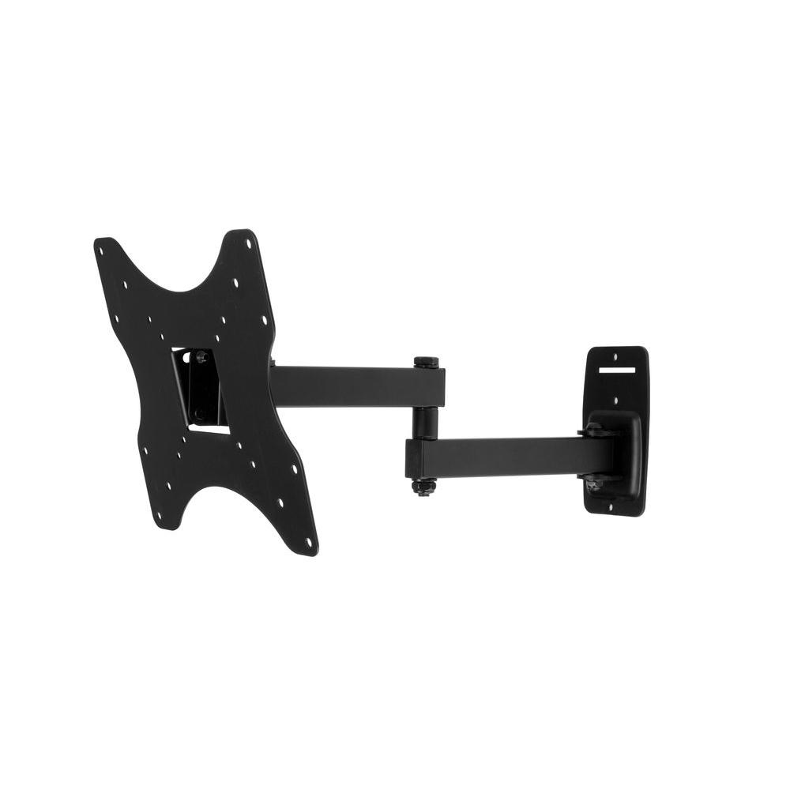
Notable Features
Max extension: 15.75 inches
Vertical range: 0 inches
Max weight: 44lbs
Cost: $19
Many mounting hole options
https://www.homedepot.com/p/SwiftMount-Full-Motion-TV-Mount-for-0-in-39-in-Flat-Panel-TVs-SWIFT240-AP/205614325?MERCH=REC-_-undefined-_-207145063-_-205614325-_-N

Slide 7
Full Off-the-Shelf Adjustability

Slide 8
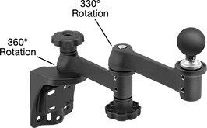
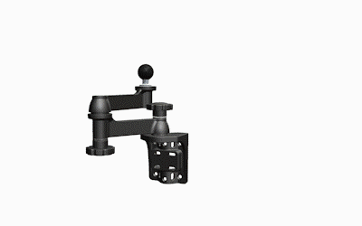
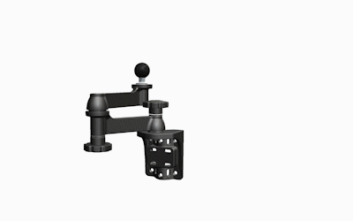
Notable Features
Max extension: 15.25 inches
Vertical range: 0 inches
Max weight: 10lbs
Cost: $139
https://www.mcmaster.com/5031t25

Slide 9
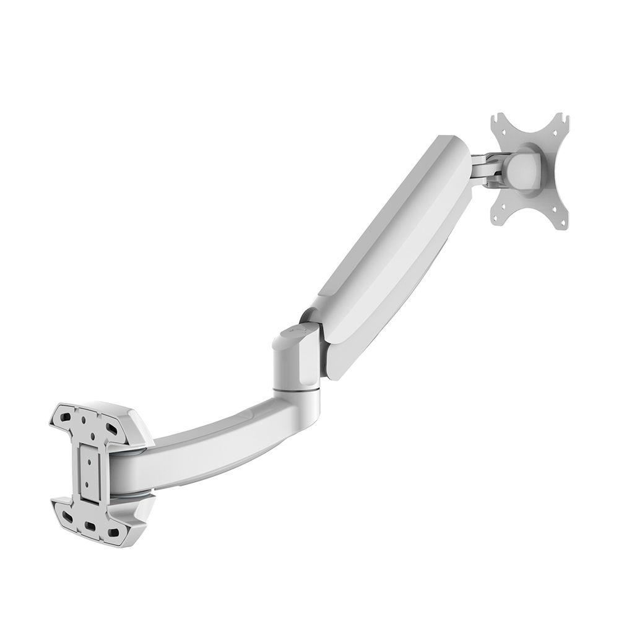
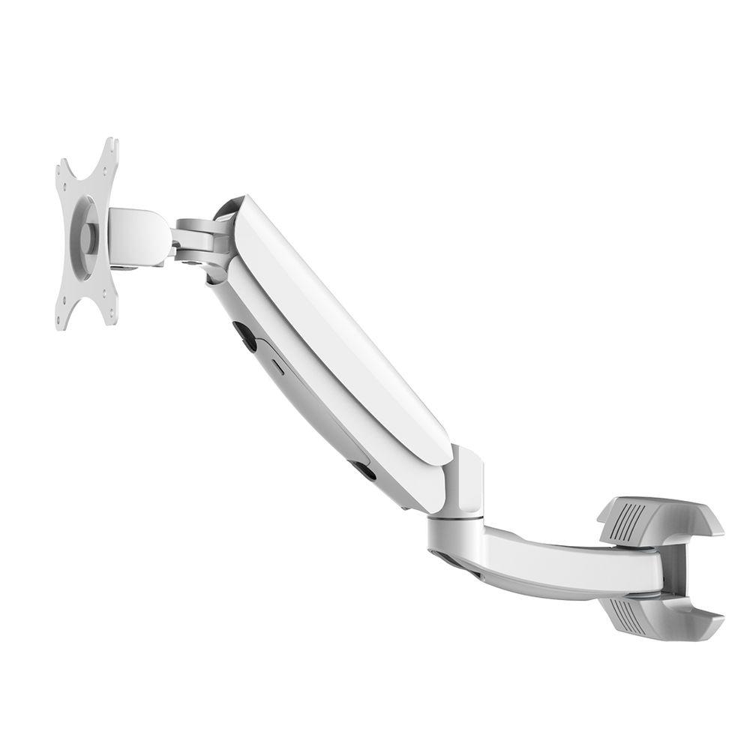
Notable Features
Max extension: 22.4 inches
Vertical range: -2.6 to +9.2 inches
Max weight: 11lbs
Cost: $53
https://www.homedepot.com/p/FLEXIMOUNTS-Full-Motion-LCD-Arm-Monitor-Wall-Mount-for-Most-10-in-24-in-Flat-Panels-Screen-for-Dental-Clinic-M09W/207145070

Slide 10
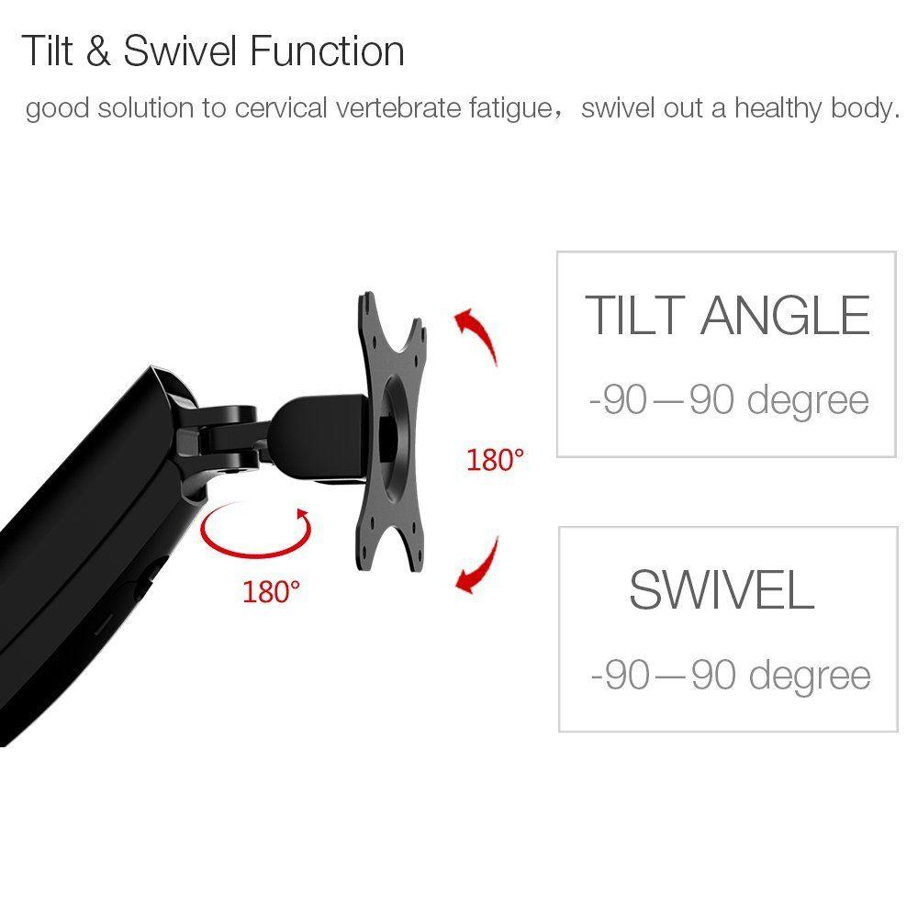
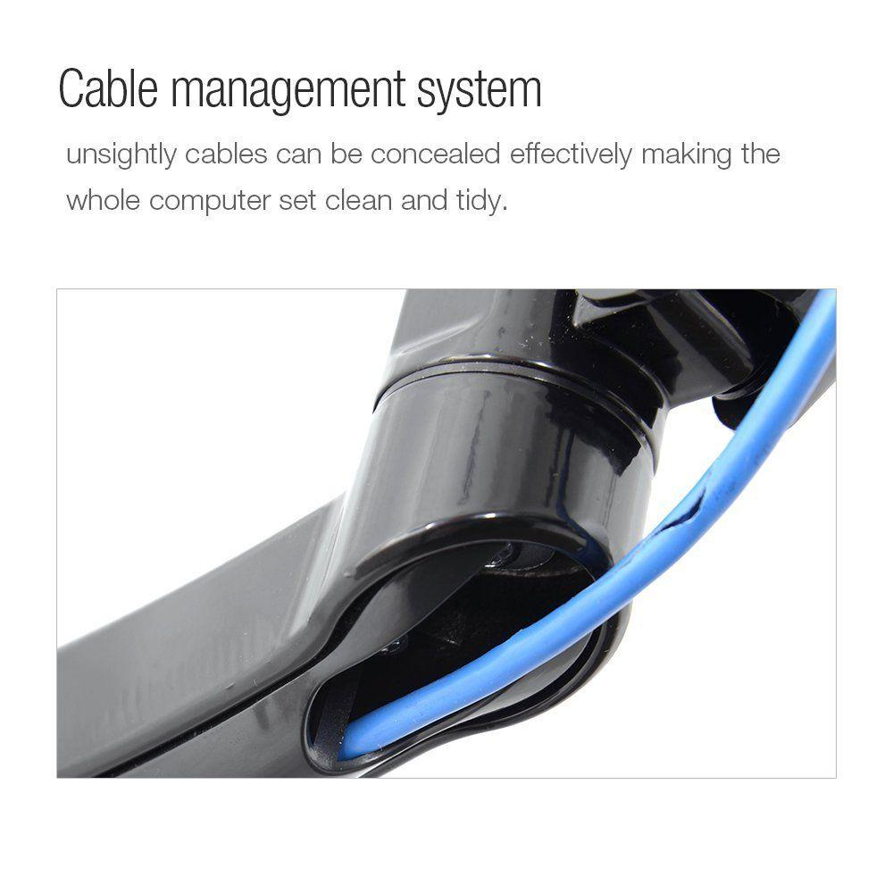
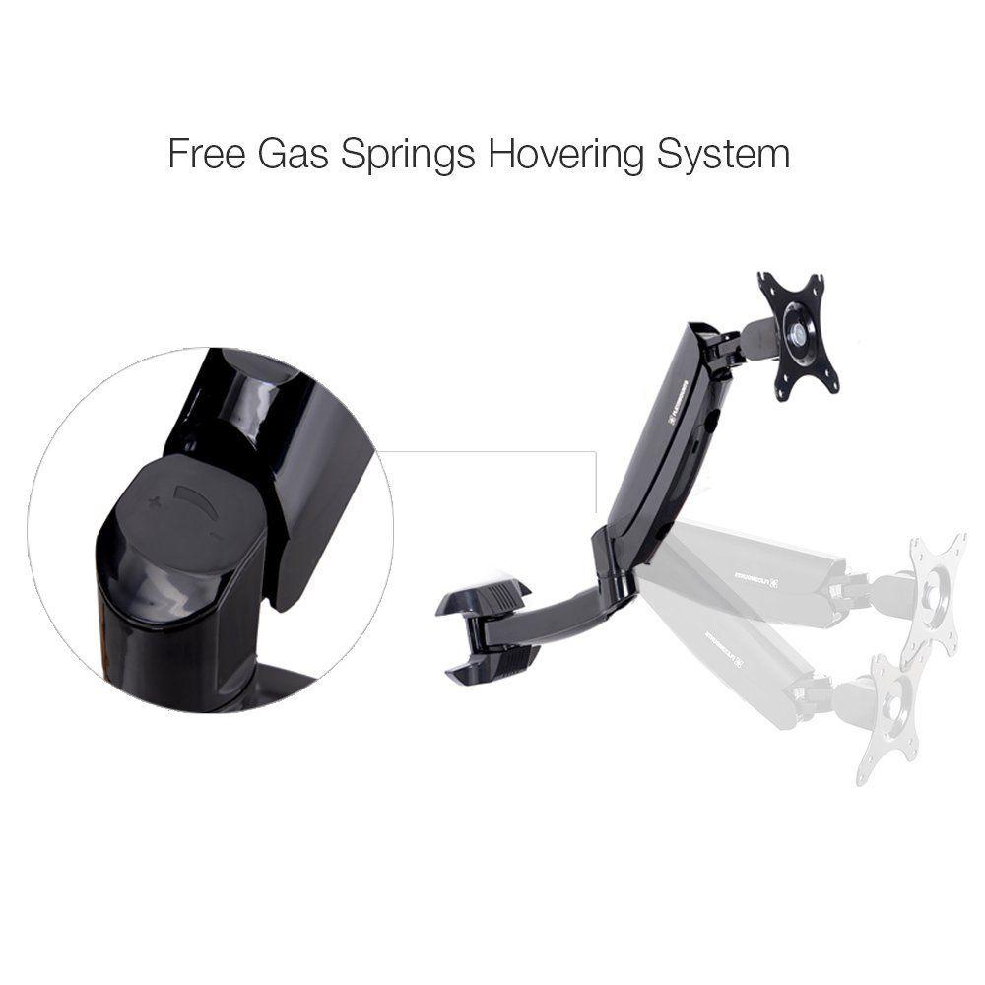
Notable Features
Max extension: 22.4 inches
Vertical range: -2.6 to +9.2 inches
Max weight: 11lbs
Cost: $51
https://www.homedepot.com/p/FLEXIMOUNTS-Full-Motion-LCD-Arm-Monitor-Wall-Mount-for-Most-10-in-24-in-Flat-Panels-Screen-for-Dental-Clinic-M09/207145069

Slide 11
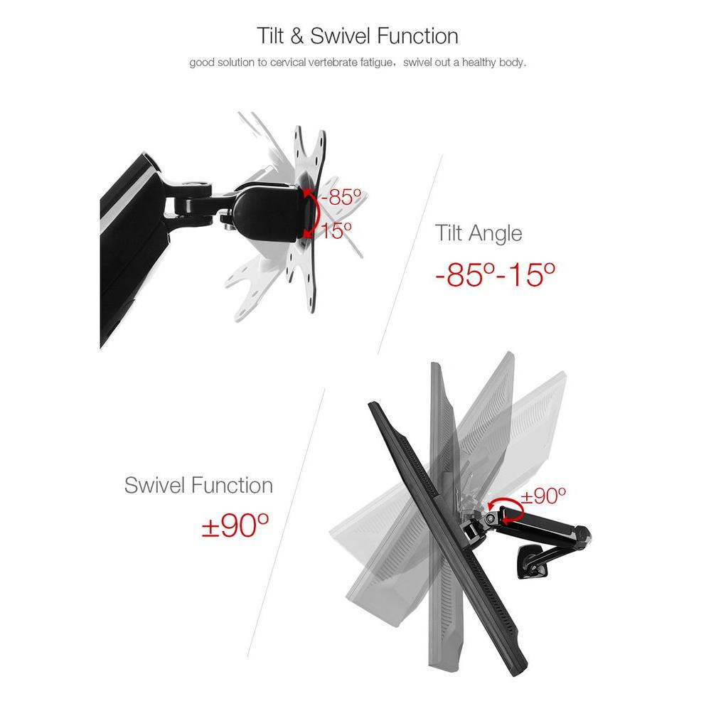
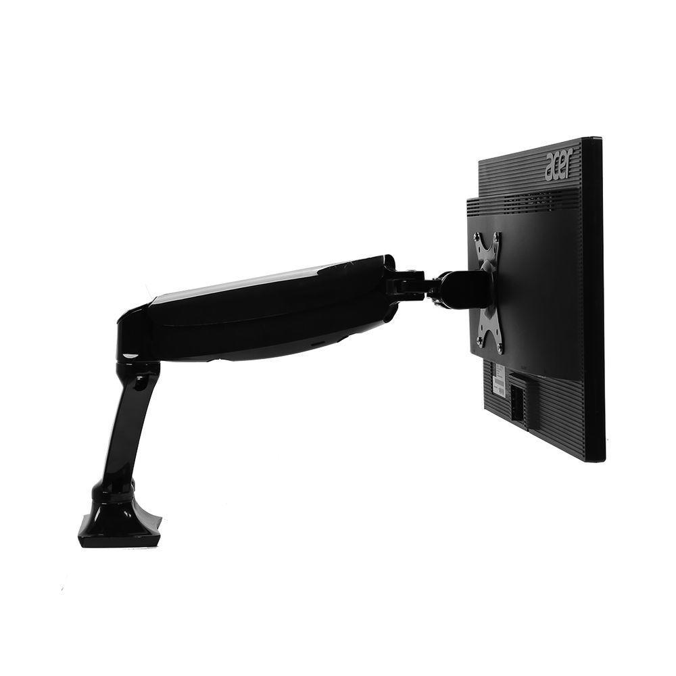
Notable Features
Max extension: 20 inches
Vertical range: 15.7 inches
Max weight: 11lbs
Cost: $42
https://www.homedepot.com/p/FLEXIMOUNTS-Desk-Mounts-Stand-Monitor-Arm-for-10-in-24-in-LCD-Screens-Both-Clamp-or-Grommet-Support-M01/207145066

Slide 12
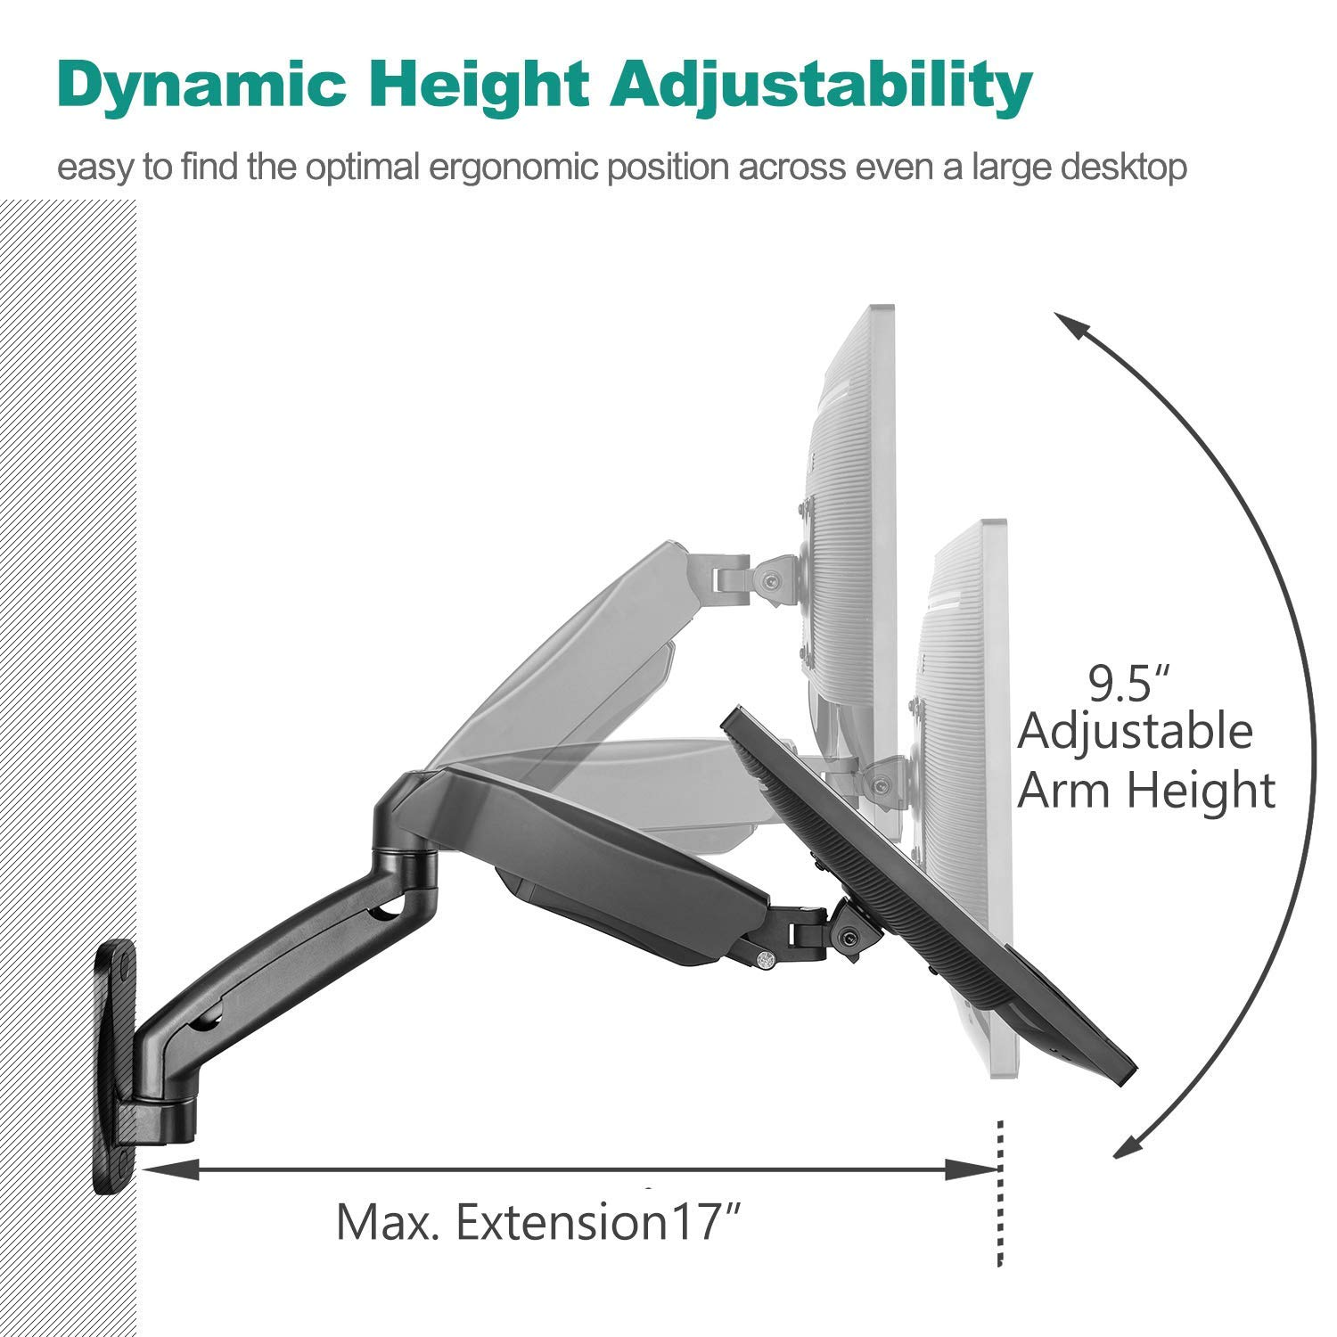
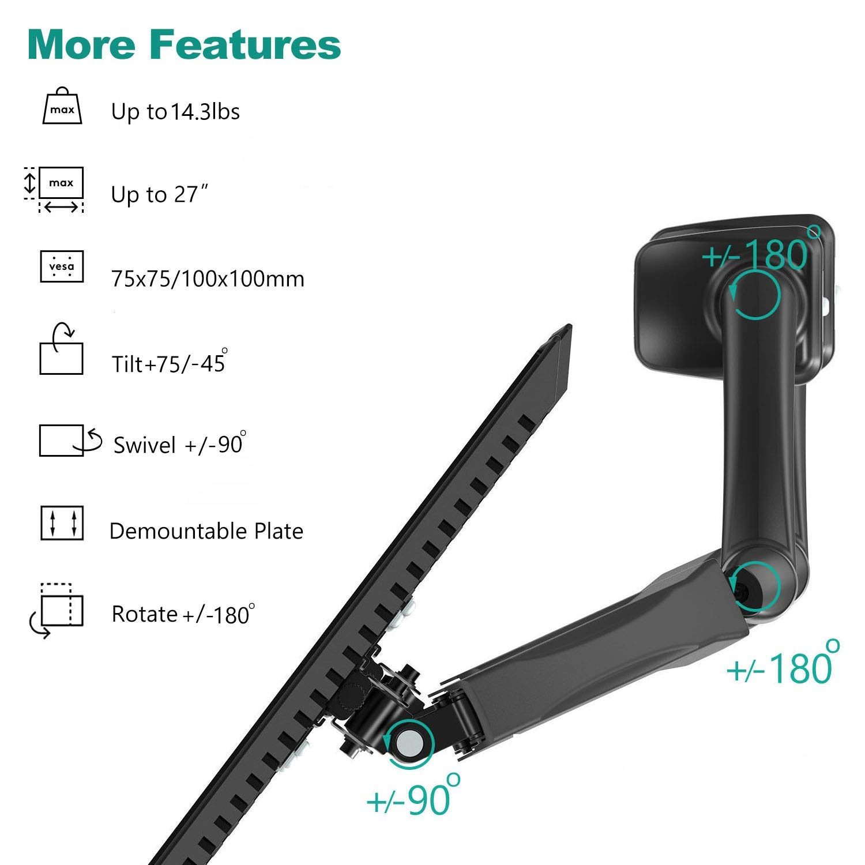
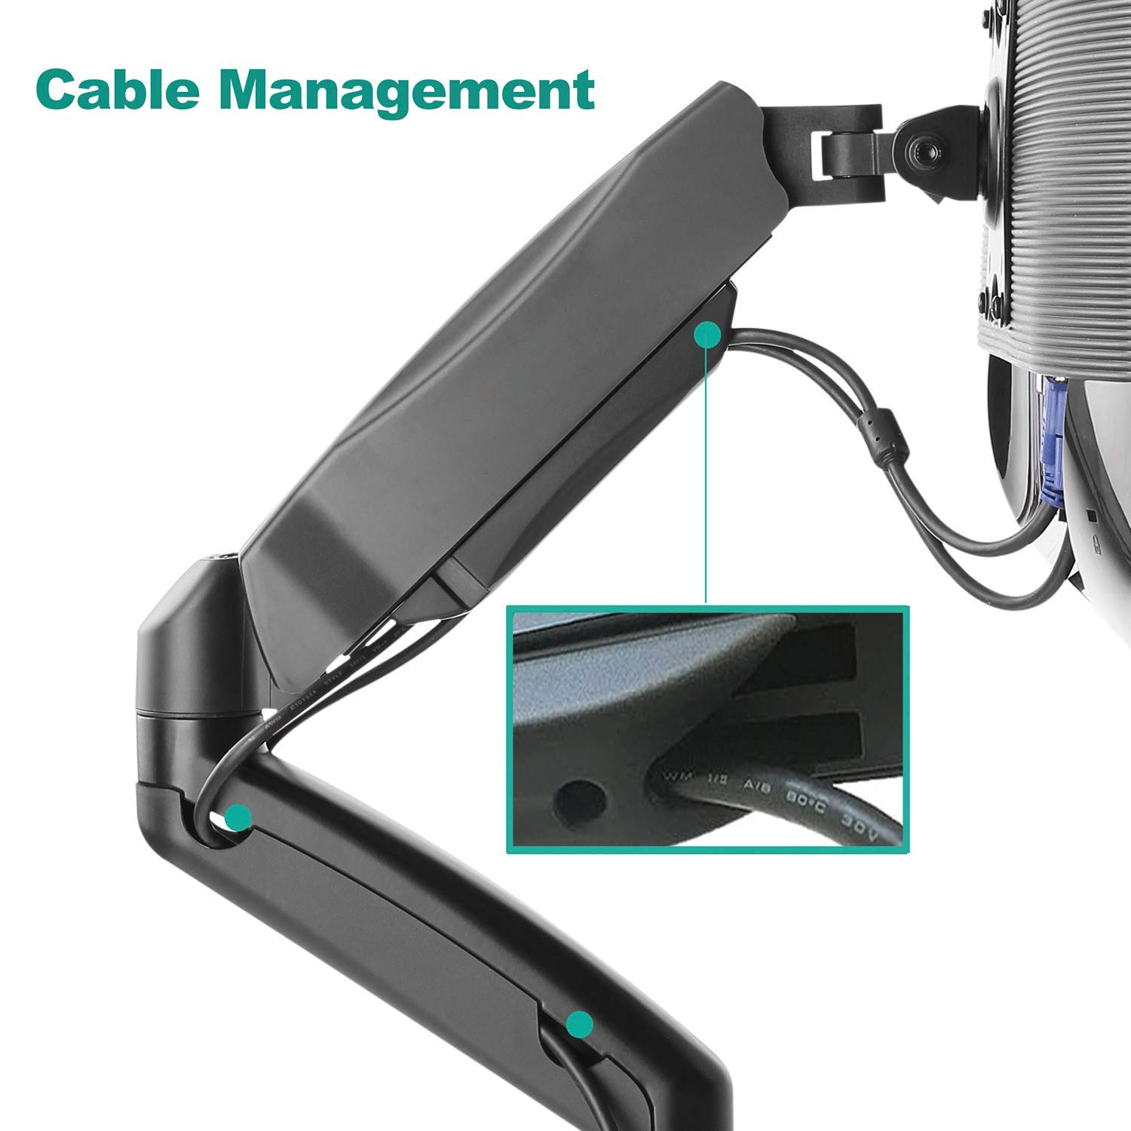
Notable Features
Max extension: 17 inches
Vertical range: 13 inches
Max weight: 14.3lbs
Cost: $34
https://www.amazon.com/dp/B01NBYJ6X6/ref=psdc_10967501_t1_B010QZCT5W

Slide 13
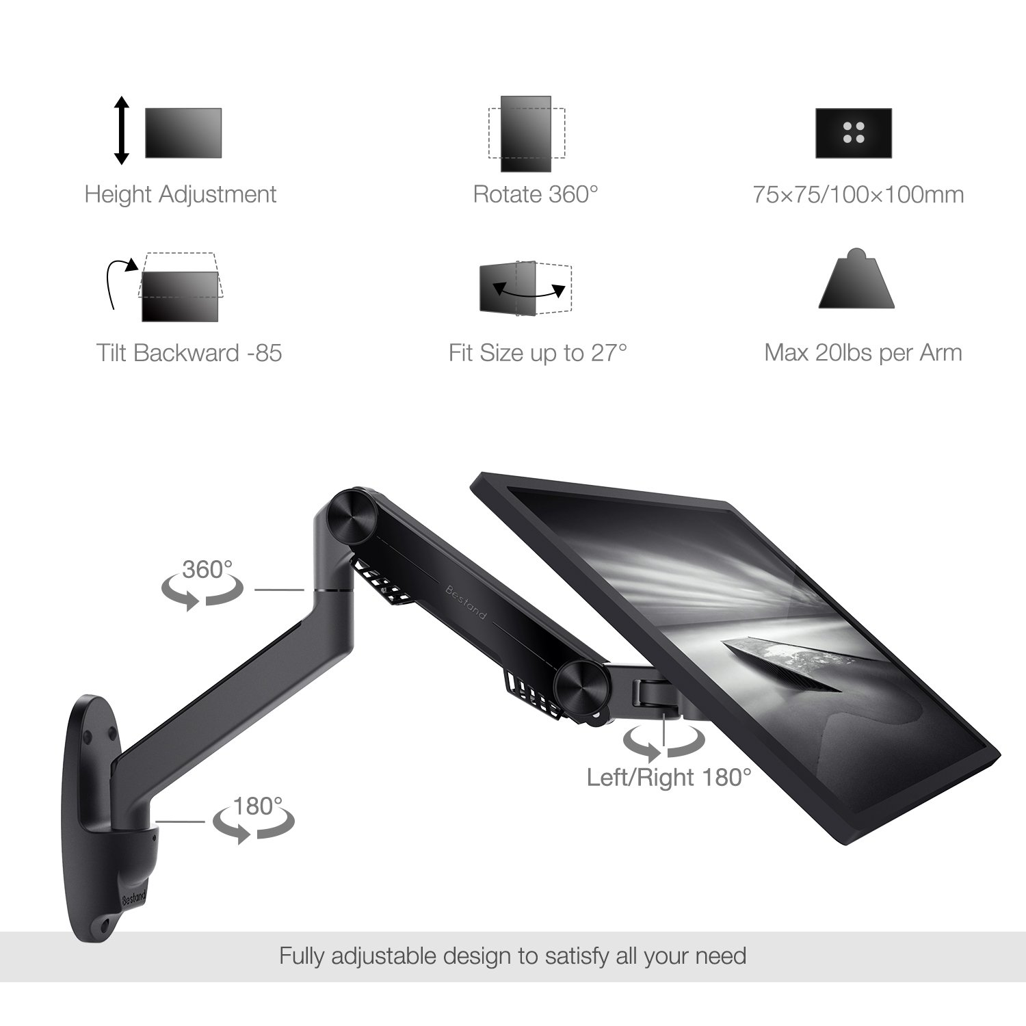
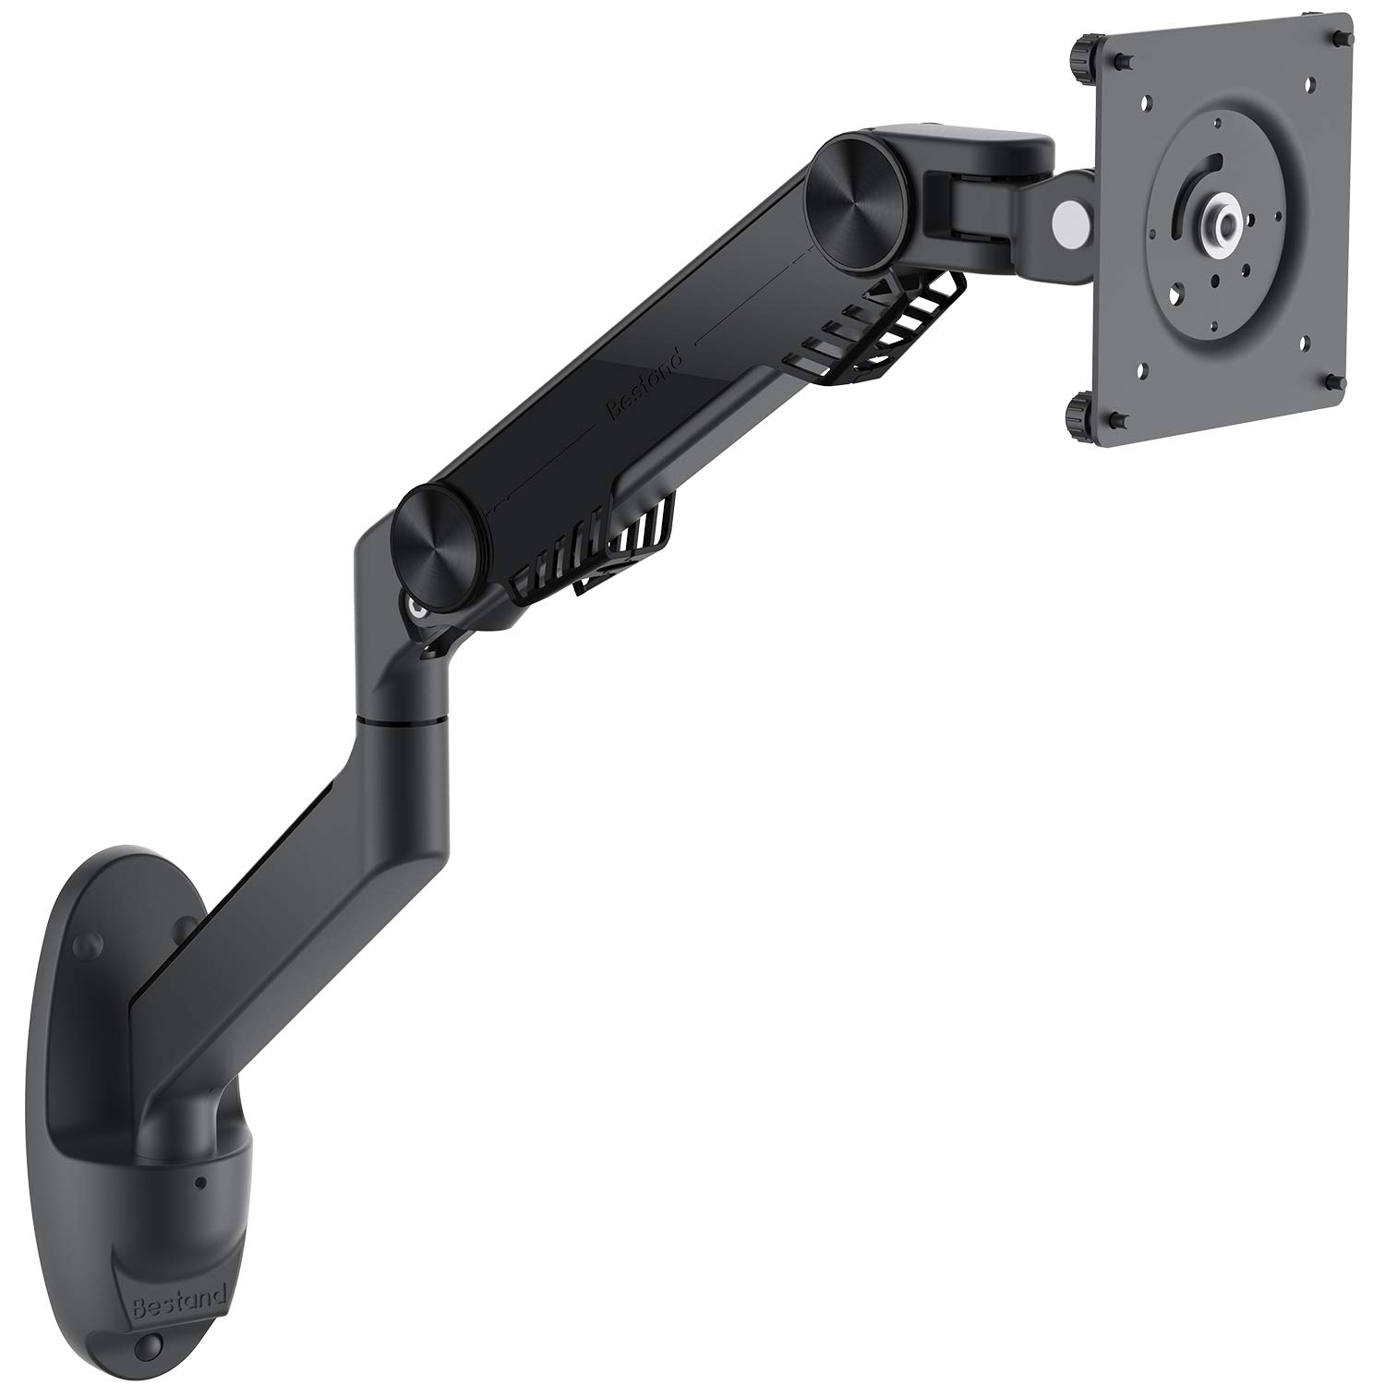
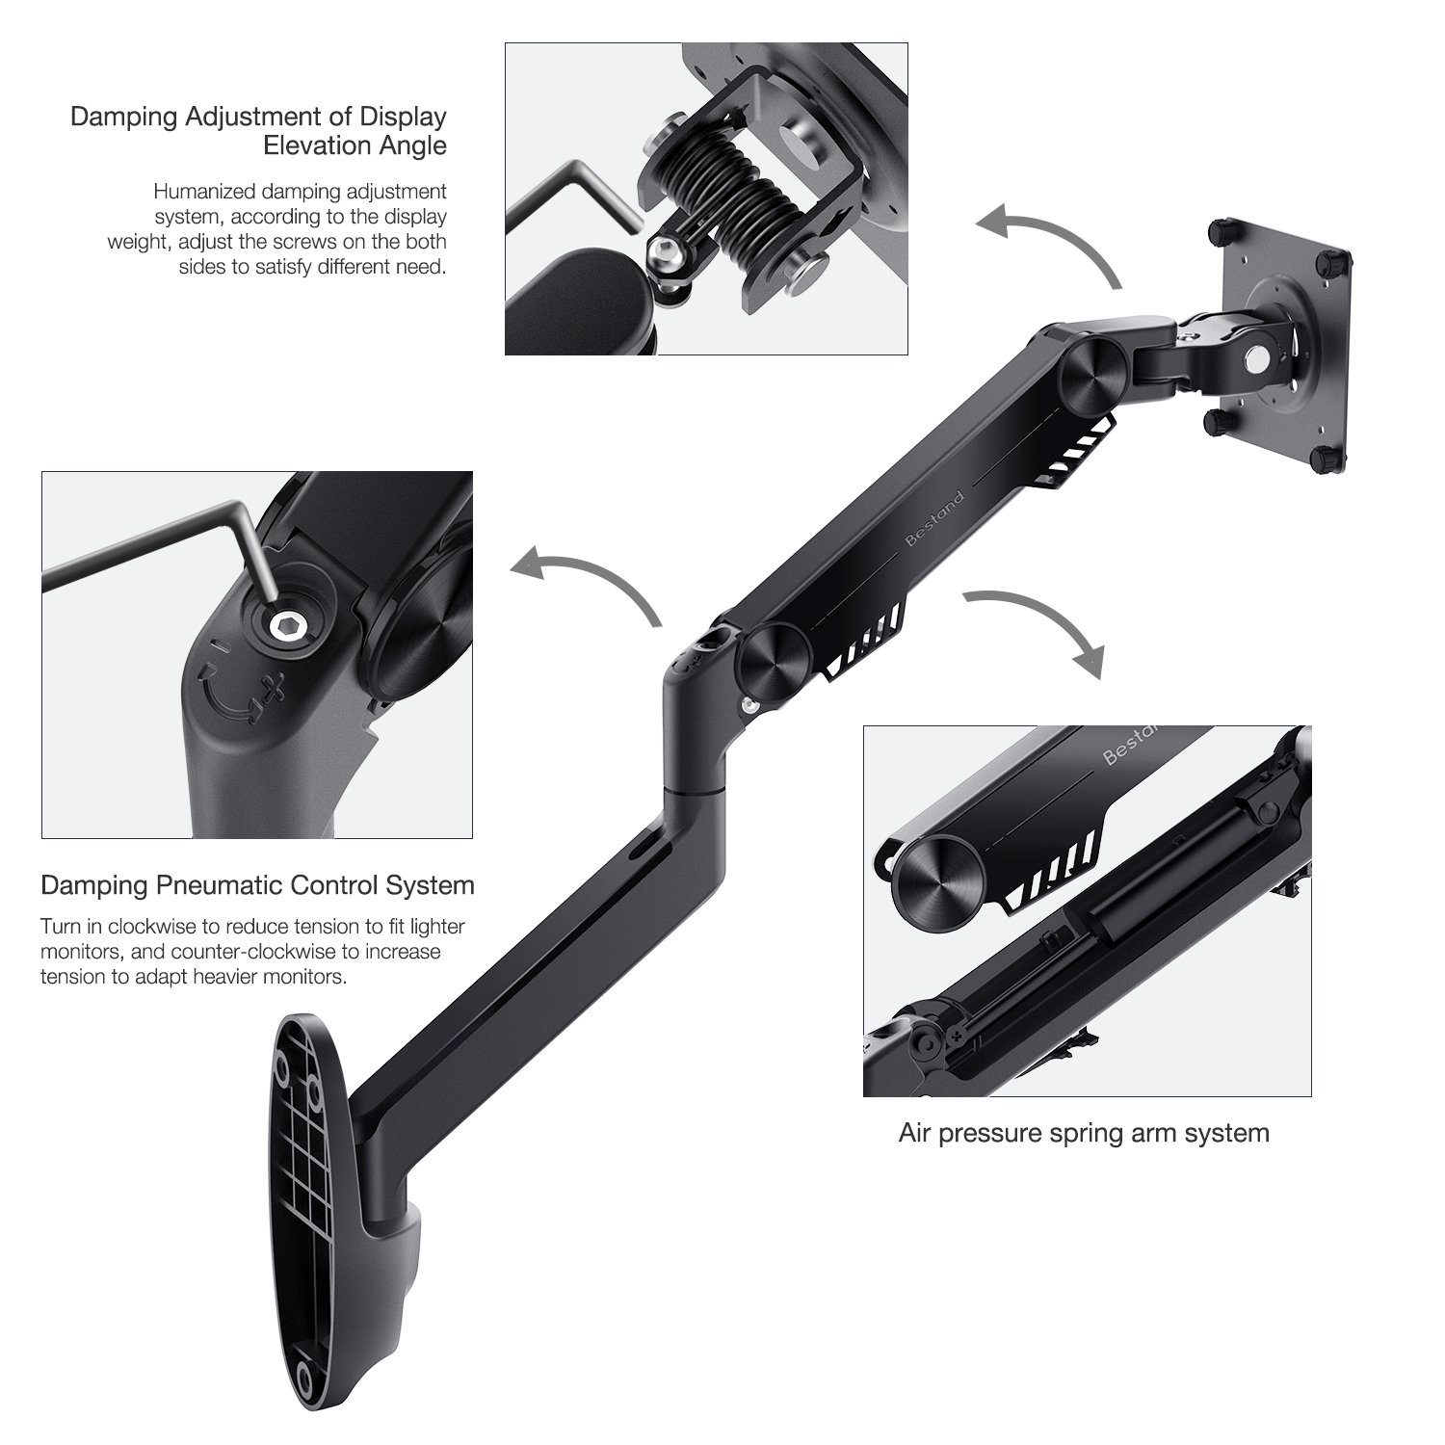
Notable Features
Max extension: 23.5 inches
Vertical range: 18.5 inches
Max weight: 19.8lbs
Cost: $71
https://www.amazon.com/dp/B077HWP67J/ref=psdc_10967501_t3_B010QZCT5W

Slide 14
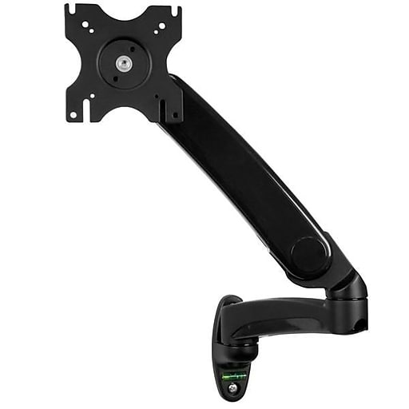
Notable Features
Max extension: 24.4 inches
Vertical range: 11.8 inches
Max weight: 19.9lbs
Cost: $102
https://www.staples.com/StarTech-com-Single-Monitor-Arm-for-12-30-Screen-Black-ARMPIVWALL/product_IM14T5607

Slide 15
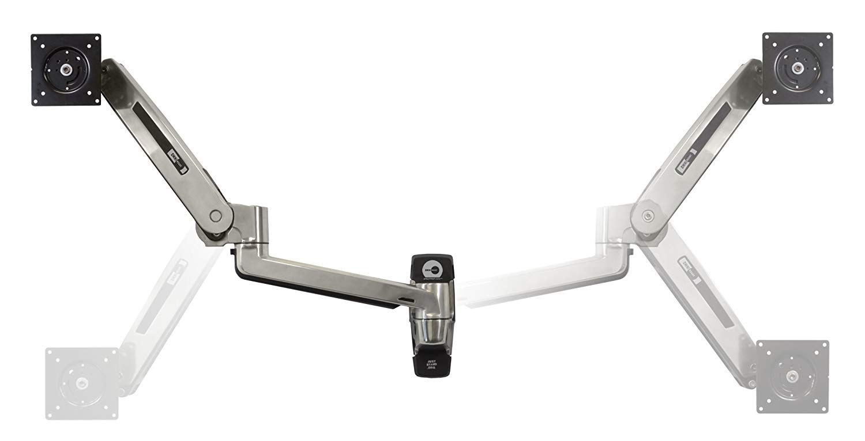
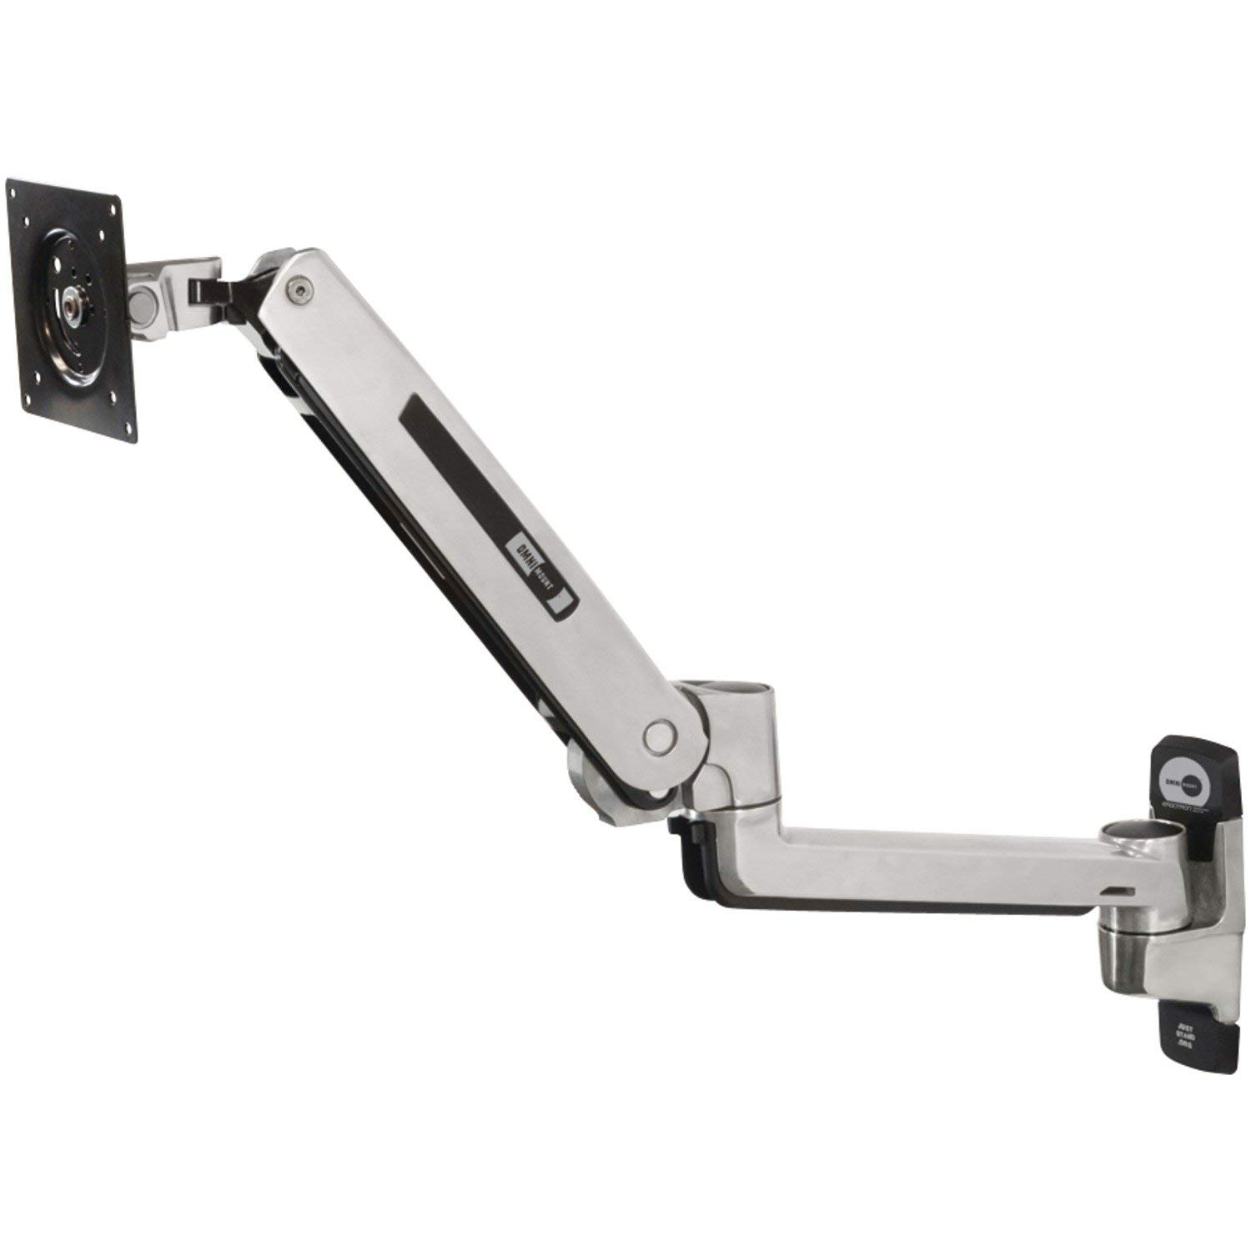
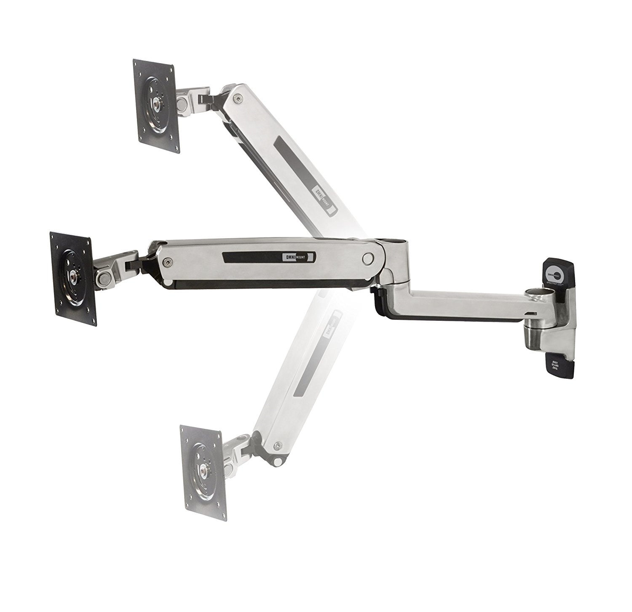
Notable Features
Max extension: 33.5 inches
Vertical range: 20 inches
Max weight: 25lbs
Cost: $156
https://www.amazon.com/dp/B00BCA41C0/ref=psdc_10967501_t2_B010QZCT5W

Slide 16
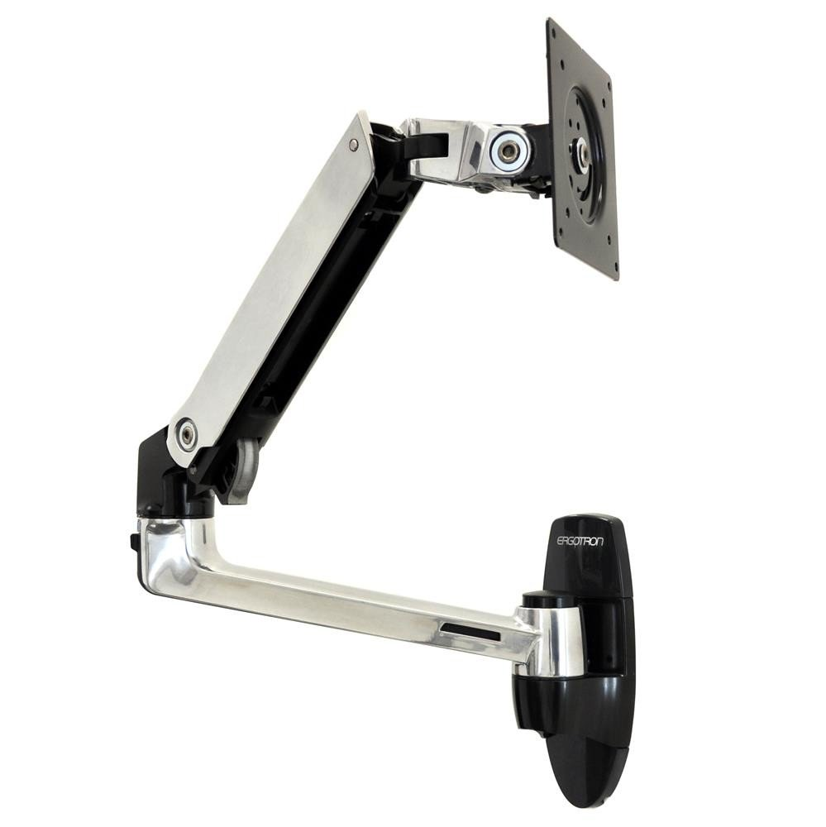
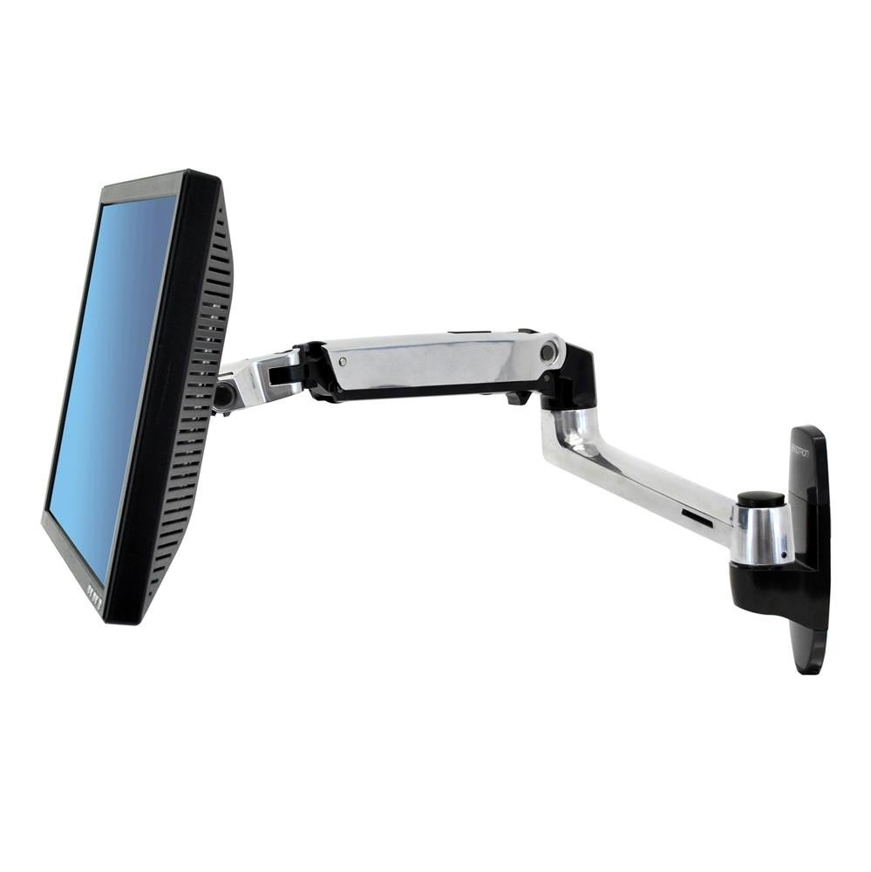
Notable Features
Max extension: 25 inches
Vertical range: 13 inches
Max weight: 25lbs
Cost: $169
https://store.ergotron.com/lx-wall-monitor-arm.html?gclid=CjwKCAiAkrTjBRAoEiwAXpf9CWHRhWNPFJsjUTjkVDofaTBnPl_FV5V9_O1N71_YS-cPKZZP8H4w-RoCiyQQAvD_BwE

Slide 17
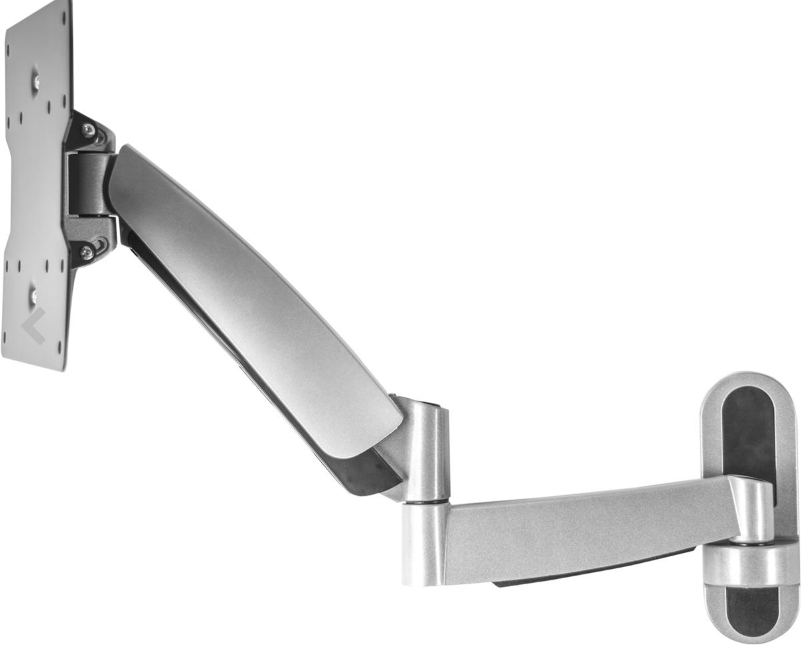
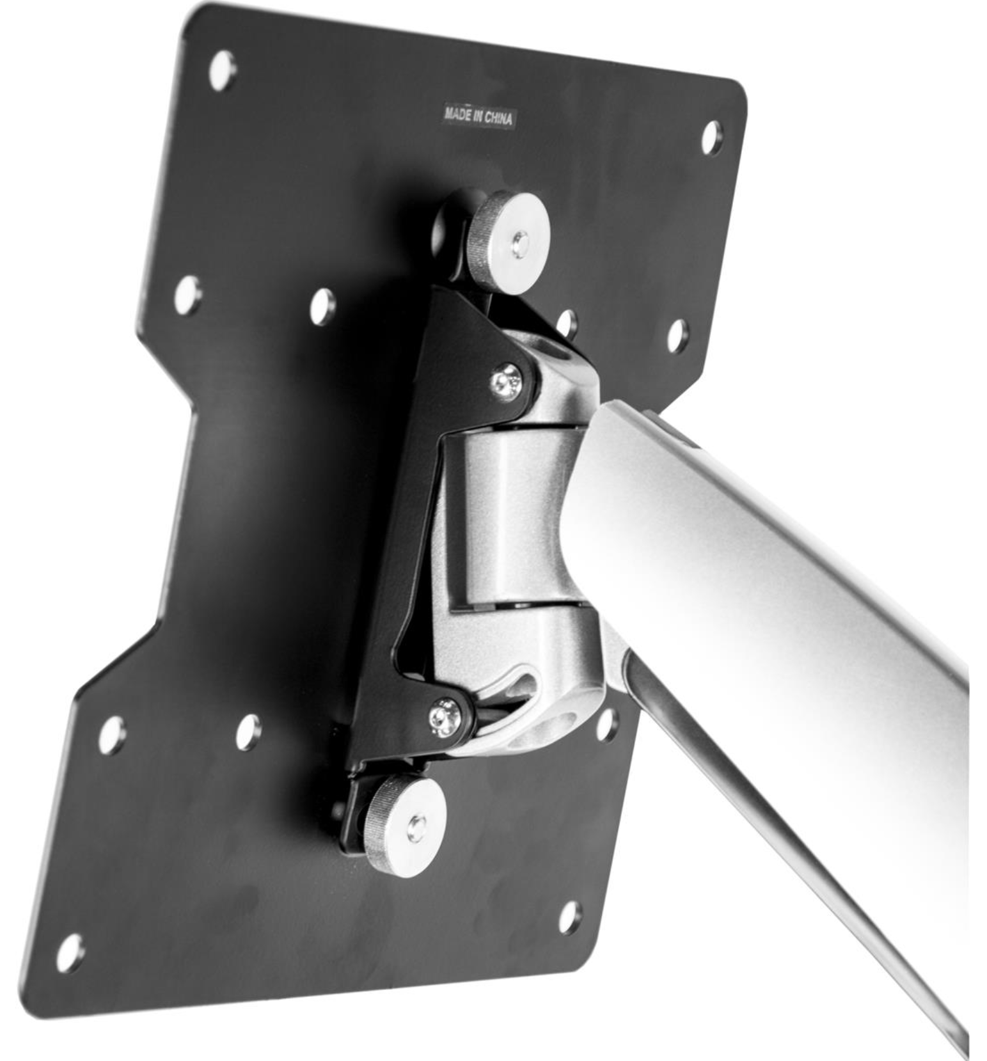
Notable Features
Max extension: 24 inches
Vertical range: 12 inches
Max weight: 44lbs
Cost: $82
https://www.displays2go.com/P-22475/Wall-Mounted-Monitor-Arm-for-Full-Motion-Mounting-Solutions

Slide 18
Build-Your-Own

Slide 19
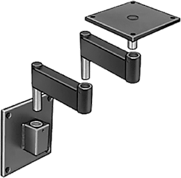
Notable Features
Max extension: 24 inches
Vertical range: 0 inches
Max weight: 100lbs
Cost: ~$320
https://www.mcmaster.com/=1gvcvzd

Slide 20
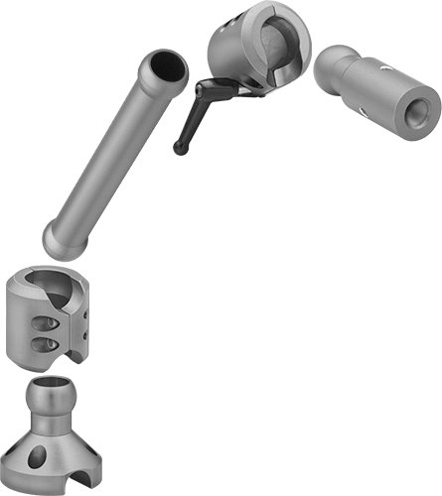
Notable Features
Max extension: 28 inches
Vertical range: 12 inches
Max weight: 35lbs
Cost: ~$200
https://www.mcmaster.com/=1gvczl0

Slide 21
Thank You.

